Slide 1

CyberArk PAS Solution For Beginners
Overview of CyberArk PAS Solution
-Sudhakar P

Slide 2
What is a Privileged Account?
Privileged accounts are valid credentials used to gain access to systems. Privileged Accounts are those that allow administration of a system or provide higher level of access within a system.
These accounts are designed to be used by sysadmins to deploy and manage IT technology, like operating systems, network devices, applications and more. They are the proverbial keys to the infrastructure – which is why attackers or malicious insiders seek to steal them. They basically provide access to just about everything.
Some of the examples of privileged accounts:
Administrator , Local Administrator Accounts(Windows)
Domain Administrative Accounts
Embedded Accounts (Applications & Service Accounts)
Root Account(Unix/Linux/Solaris)
Infrastructure Accounts(Firewall , Router, LB’s, VMs..)
DB Admin Accounts, Securing Cloud Assets, DevOps Secrets Management

Slide 3
Problems Associated with Unmanaged Privileged Account
Control for Privileged Users
Accountability of Privileged Users
Rarely changed and Known to many
Footprints
Most powerful accounts in the organization.
Managing Privileged Passwords for End user
You have no record of which privileged credentials are known to different individuals
You have no proof of who has used privileged logins to gain access to any of your IT resources, when, and for what purpose
There is no way to verify that each of your privileged account passwords are cryptographically strong, are sufficiently unique, and are changed often enough to be secure
Increased Online Threat (By external hackers / Intruders)

Slide 4
Breach of Privileged Account can lead to ?
Financial Losses
Brand Damage
Business Continuity Damage
Regulatory Penalties
Customer Loss

Slide 5
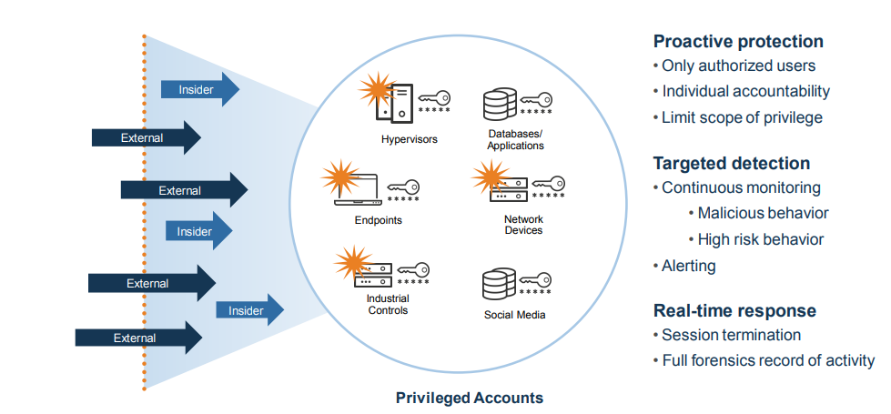
CYBERARK- PAS( Privileged Access Security): PROACTIVE PROTECTION, DETECTION, & RESPONSE

Slide 6
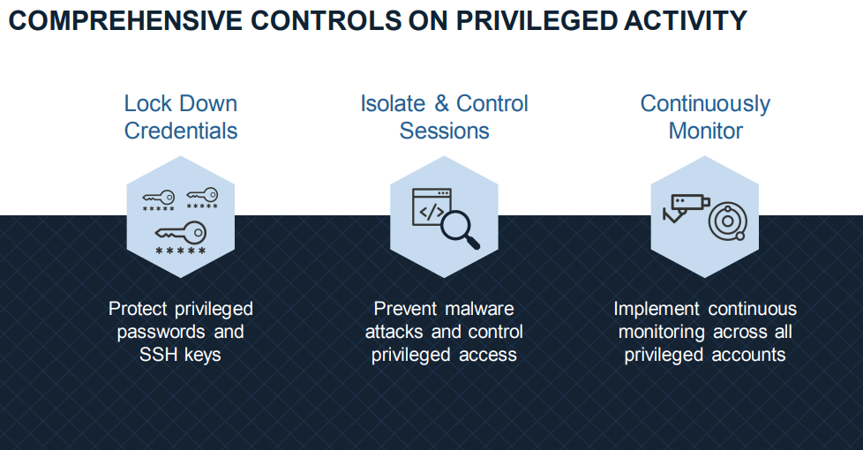

Slide 7
Introduction to CyberArk
The Cyber-Ark Company provides a ‘Safe Haven’ within your enterprise where all your administrative passwords can be securely stored and shared to authorized users, such as IT staff, on-call administrators, and local administrators in remote locations.
The PIM Suite is a plug-and-play solution which requires minimum effort to set up, and which can be fully operational in a very short period.
CyberArk is the only security company laser-focused on striking down targeted cyber threats, those that make their way inside to attack the heart of the enterprise. Dedicated to stopping attacks before they stop business.
CyberArk is trusted by the world’s leading companies to protect their highest-value information assets, infrastructure and applications.

Slide 8
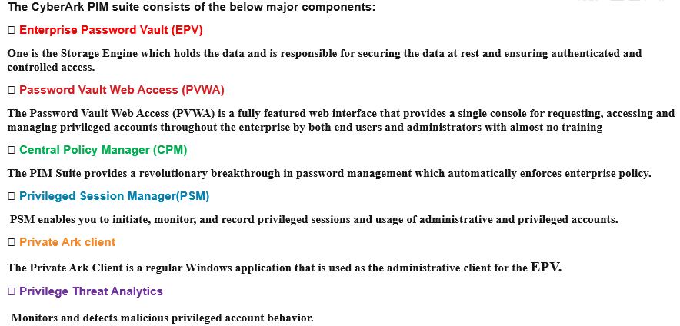
Basic CyberArk Components

Slide 9
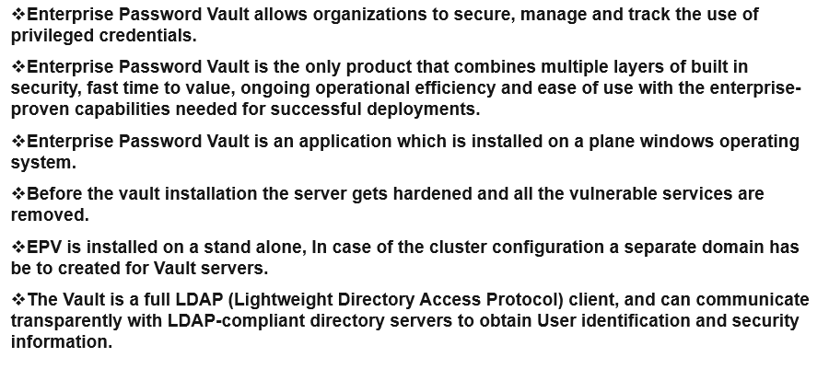
Overview of Enterprise Password Vault (EPV)

Slide 10
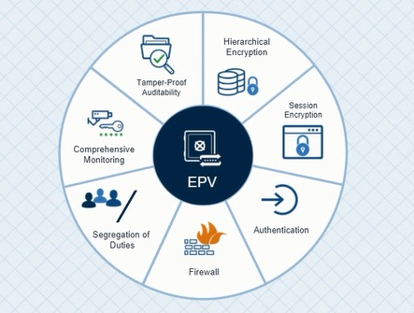
Vault 7 Security Layers:

Slide 11
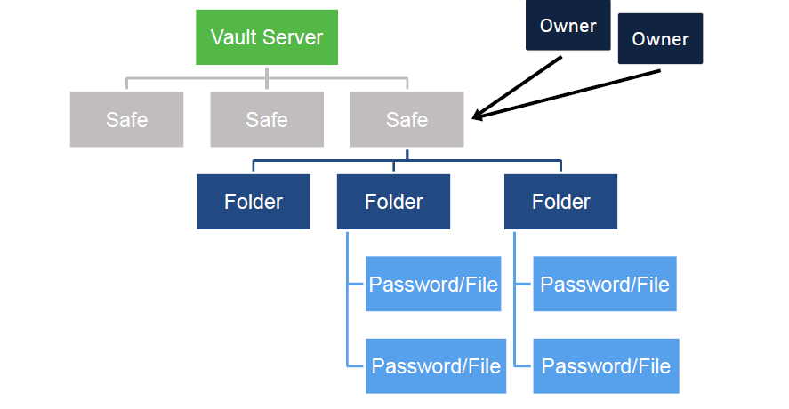
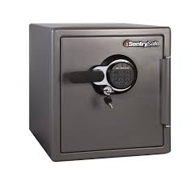
What is a Safe? It’s a logical space/Basic Access Control Unit in the Vault.

Slide 12
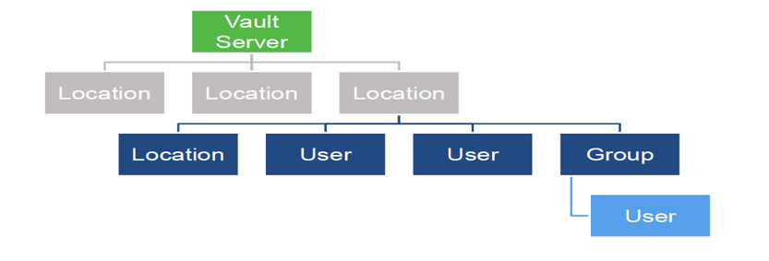
Users and Groups Hierarchy

Slide 13
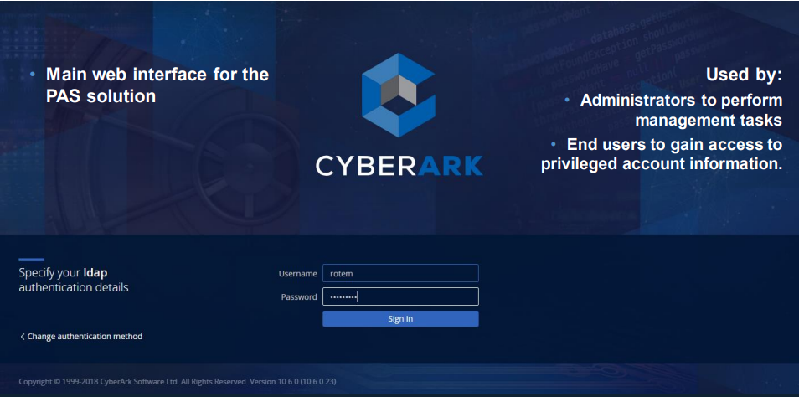
Password Vault Web Access
The Password Vault Web Access enables both end users and administrators to access and manage privileged accounts from any local or remote location through a web client.

Slide 14
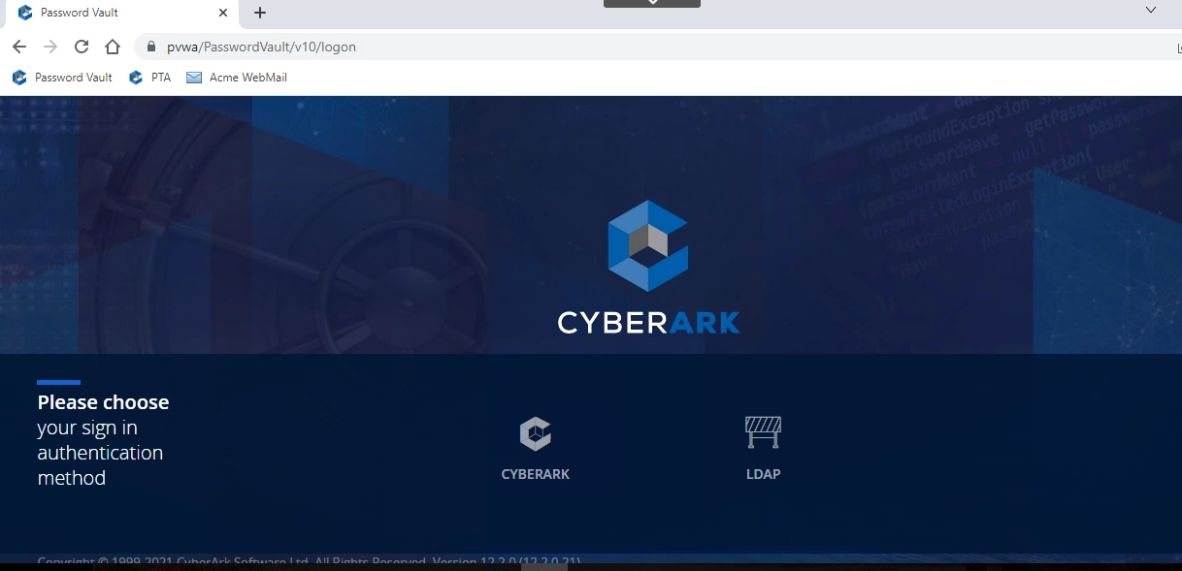
Multiple Authentication Methods

Slide 15
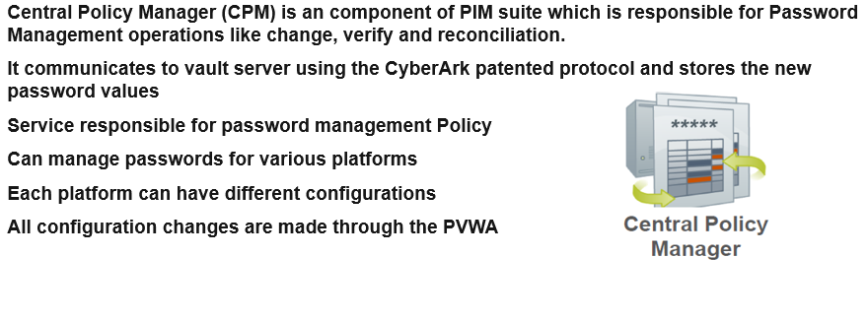
Overview of Central Policy Manager (CPM)

Slide 16
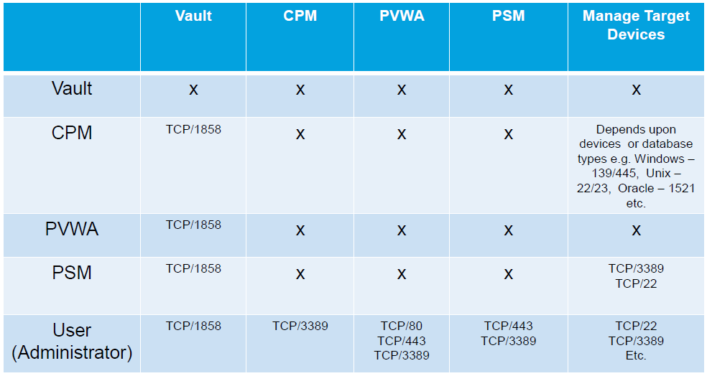
Communication Matrix

Slide 17
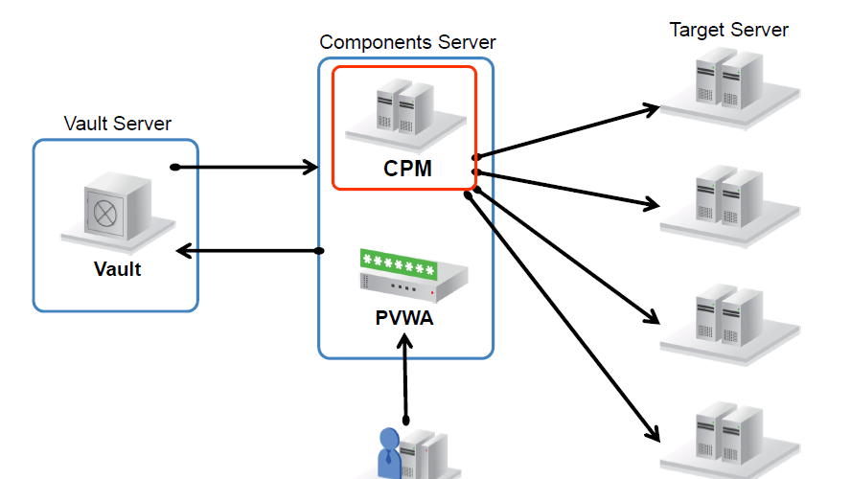

Slide 18
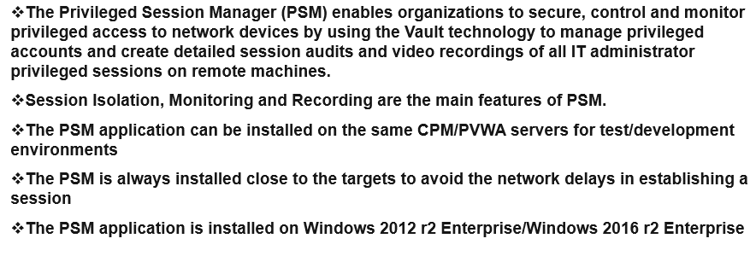
Privileged Session Management (PSM)

Slide 19
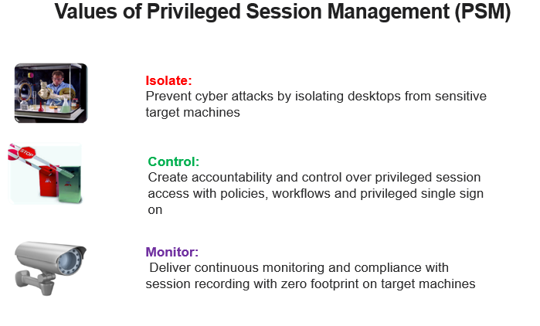

Slide 20
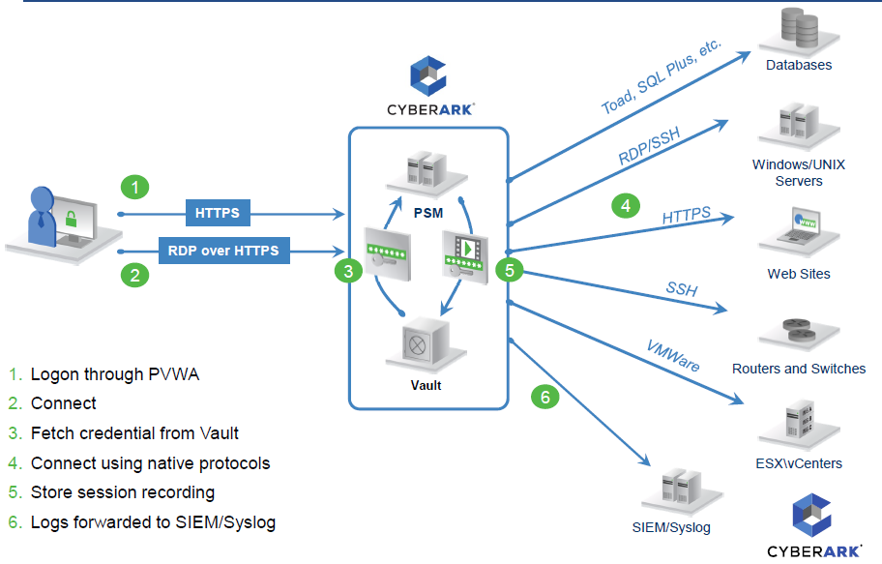
PSM Architecture

Slide 21
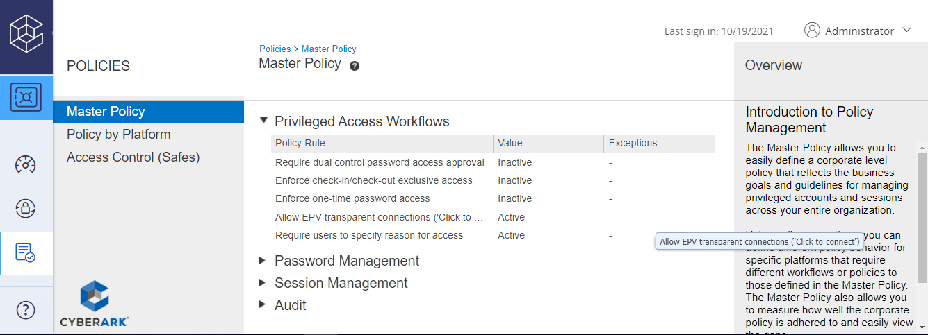
The Master Policy
Offers a centralized overview of the security and compliance policy of privileged accounts in your organization while allowing the ability to configure compliance driven rules that are define as the baseline of the enterprise.
Configured out-of-the-box and can be used immediately after implementation, providing an intuitive, simplified user experience and enhanced bottom-line insight for administrators, IT personnel, managers and auditors.

Slide 22
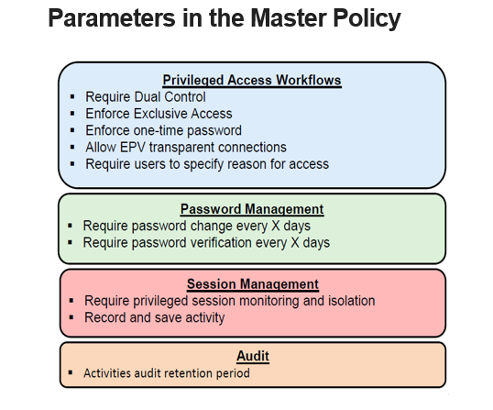

Slide 23
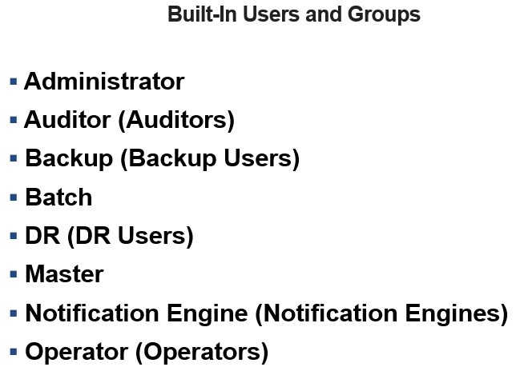

Slide 24
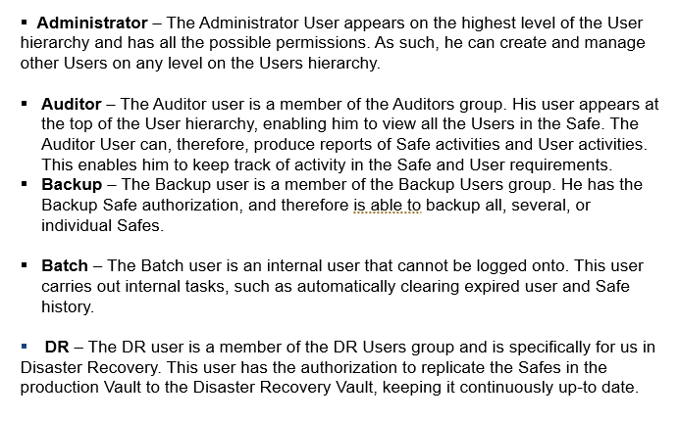

Slide 25
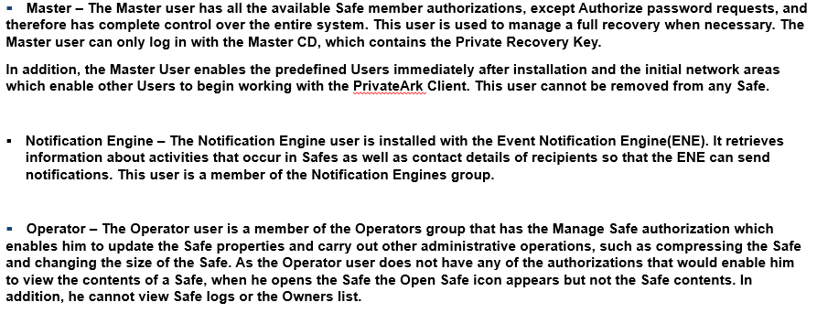

Slide 26

Thank you

